Slide 1


SQL Server monitoring using Prometheus
Vahid farahmandian

Slide 2

Who am I?
Vahid Farahmandian
Born on 1989 in Urmia, Iran
Chief Software Engineer
CEO @ Spoota Co.
Former DB Consultant in:
IR RAI Organization
IR PMO Organization
IR Day Insurance Company

Slide 3

Value of monitoring

Slide 4
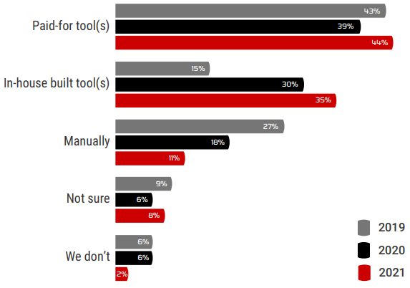
How does your organization currently monitor your DBs, instances and servers?

Slide 5
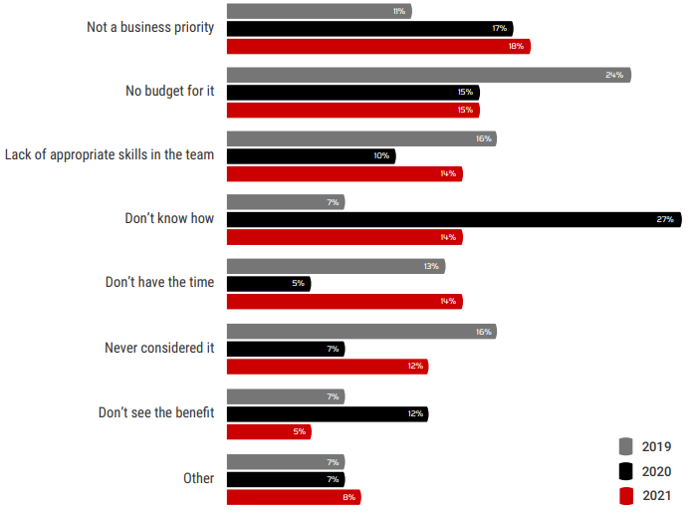
Why doesn’t your organization currently monitor your DBs, instances and servers?

Slide 6
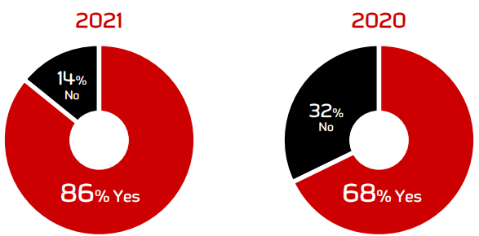
Are you satisfied with your current monitoring solution?

Slide 7
How to convince your boss you need SQL Server monitoring
Without Monitoring Tool
Monthly working 176 hours
Hourly Salary = $45
Monthly Salary: $7920
Servers count: 20
Daily effort per-server: 10minutes
Total Per-Day effort: 200 minutes
Monitoring Cost Per-Day: $150
Total Cost for 250 working days: $37,500
With Monitoring Tool
Monthly working 176 hours
Hourly Salary = $45
Monthly Salary: $7920
Servers count: 20
Daily effort per-server: 10minutes
Total Per-Day effort: 10 minutes
Monitoring Cost Per-Day: $7.5
Total Cost for 250 working days: $1,875

Slide 8
How to convince your boss you need SQL Server monitoring

Slide 9


Slide 10
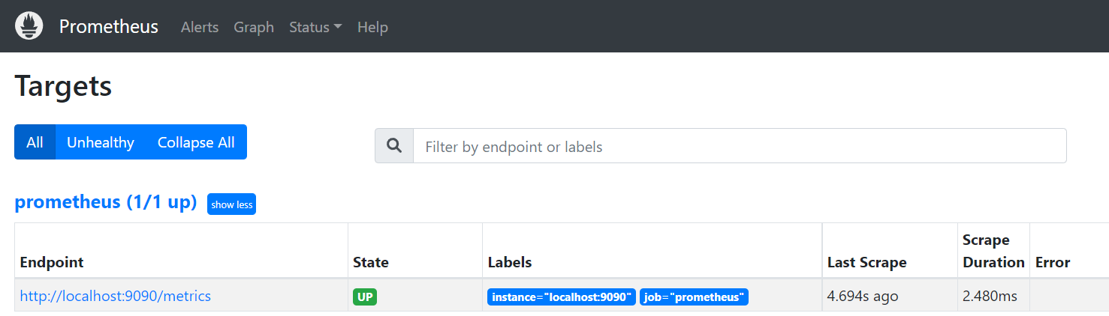
How to install
Download prometheus zip file and extract it
Run the following command to start the prometheus:
prometheus.exe --config.file prometheus.yml --web.listen-address ":9090" --storage.tsdb.path "data”
Access the prometheus web Url to verify the installation

Slide 11
Add sql exporter
SQL Exporter is a configuration driven exporter that exposes metrics gathered from DBMSs, for use by the Prometheus monitoring system.
After starting the exporter, add it to the prometheus.yml and restart the prometheus and check the Targets to see if installation succeeded or not
scrape_configs:
- job_name: "sql exporter"
static_configs:
- targets: ["localhost:9399"]

Slide 12


Slide 13
How to install Grafana
Download and install Grafana
Verify that your Grafana service is running
By default Grafana’s default port is 3000, or you can check its windows service
You can change Grafana’s default port by editing to conf/default.ini
Launch Grafana
Default username and password are: admin
Configure data sources

Slide 14
Adding Prometheus Data Source on Grafana
Go to Configuration>Data Source click on Add data source
Select Prometheus and set a name for the data source
Set the Prometheus URL
Select the Access Mode
Server: Request will be made from browser to Grafana backend and then will be forwarded to the data source
Browser: Request will be made from browser directly to the data source

Slide 15
Explore & alerting
Explore:
Go to explore and select the data source
Select the appropriate metric and operation
Click on Add to Dashboard to add the query result to dashboard
Save the Dashboard
Alerting
Define the alerting query and condition
Configure alerting contact points

Slide 16
Contact me
Email: farahmandian2011@gmail.com
Twitter: _jinget
Instagram: VahidFarahmandian
GitHub: VahidFarahmandian
LinkedIn: VFarahmandian
YouTube: Jinget dot Net

Slide 17


